Slide 1
Visual Perception

Slide 2
More Pictures

Slide 3
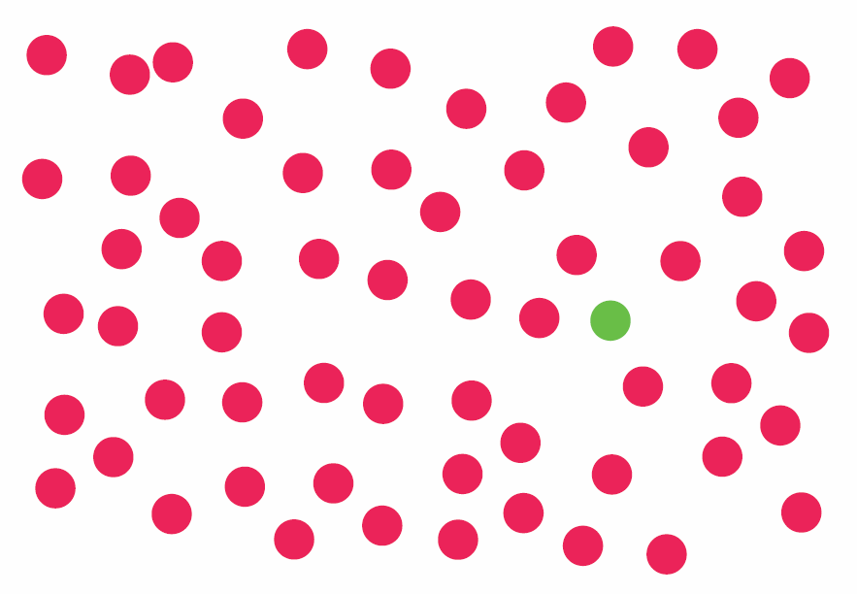

Slide 4


Slide 5


Slide 6


Slide 7
What Stands Out? (What We Can Easily See)

Slide 8
Quickly Browsing to Identify Objects of Interest Is Important.
We can spot these objects more quickly than others.

Slide 10
Pop Out Effect
Certain unique features make an object pop out of the distracters in the background.
The number of distracters does not matter.
Very quick
0.1 second

Slide 11
Pop Out Effect
Certain unique features make an object pop out of the distracters in the background.
The number of distracters does not matter.
Very quick
0.1 second
Visual distinction between the target and the distracters should be large enough.

Slide 12


Slide 13


Slide 14
Pop-out Channels
Prominent channels
Form (orientation/size)
Color
Simple motion/blinking
Spatial, stereo depth, shading, position

Slide 15
Color

Slide 16
Orientation

Slide 17
Motion

Slide 18
Size

Slide 19
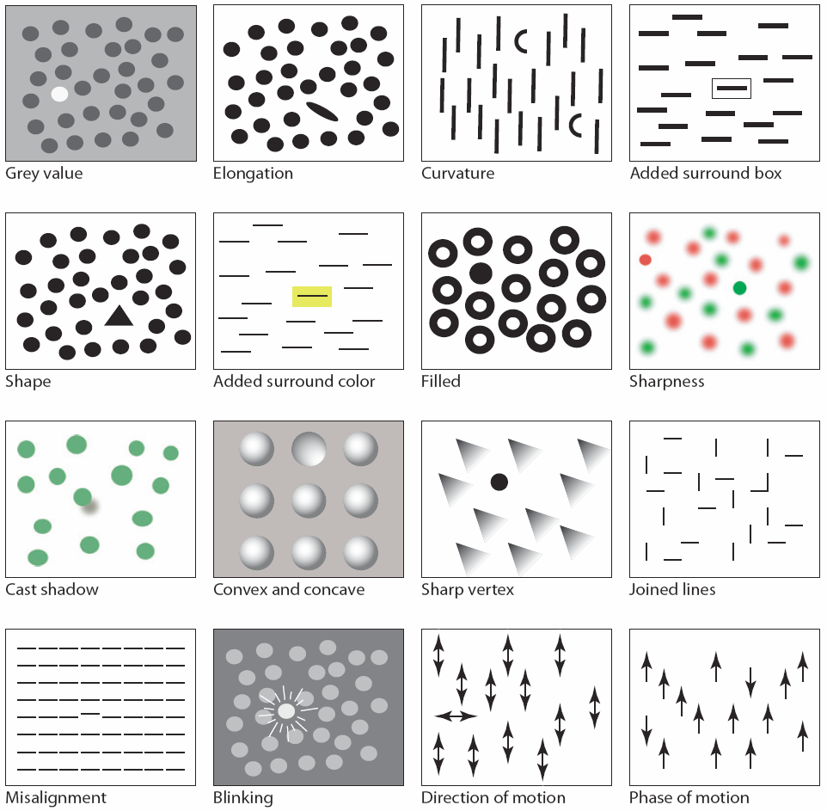
Other Channels

Slide 20
Pop-out Conjunctions
In general: spatial feature
and some aspect of form
Color and motion
Color and position
Shape and position

Slide 21
Design of Pop-out Conjunctions
Good design
Sufficient object distance in two feature dimensions
Otherwise, hard to use.
Learning does not help much.

Slide 22


Slide 23




Slide 24
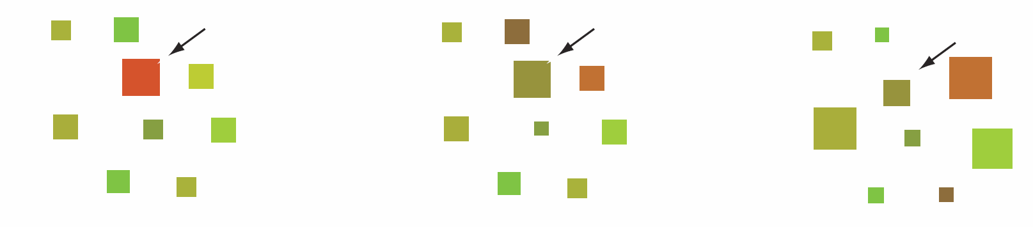
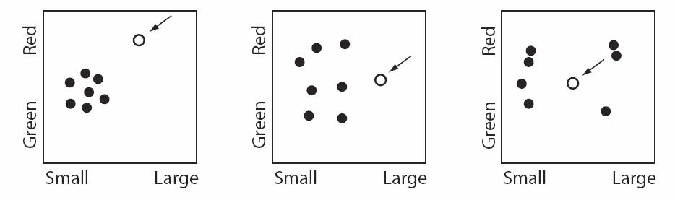

Slide 25


Visibility Enhancement Is Asymmetric
Large size vs. small size

Slide 26


Visibility Enhancement Is Asymmetric
Large size vs. small size
Adding an extra part vs. taking a part away.

Slide 27
Motion
Very powerful pop-out effect.
In particular, things that emerge into the view.
Abuse of motion
Online commercials
High-frequency, rapid motion
TV commercials

Slide 28






Slide 29
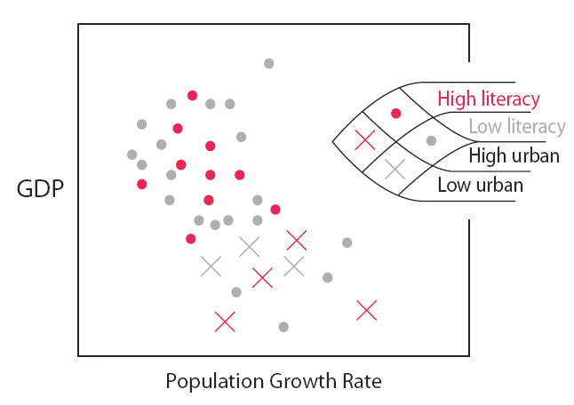
Implications for Design
Making different from its surroundings
More complex search: combining different channels
Form, color, motion
objects of interest

Slide 30
More Pictures

Slide 34


Slide 36
Organization of Visual Objects Visual Patterns

Slide 37
Visual Patterns Are Important!
Finding patterns is key to information visualization.
Expertise often is about understanding visual patterns.
Both top-down and bottom-up processes are involved.
Top-down: visual search is guided by a rough idea what the pattern is about.
Bottom-up: visual pattern is deducted from external information.

Slide 38
Static Patterns
Gestalt Laws
Proximity
Similarity
Continuity
Symmetry
Closure
Relative Size
Figure and Ground

Slide 39
Proximity
a

Slide 40
Proximity

Slide 42
Similarity
Visual Grouping by similarity

Slide 44
Continuity
Visual entities tend to be smooth and continuous

Slide 45

Closure

Slide 46
Such Patter Recognition
Very important to our perception and cognition
“The whole is greater than the sum of its parts!”

Slide 47
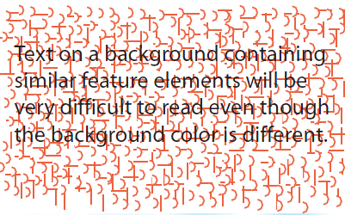
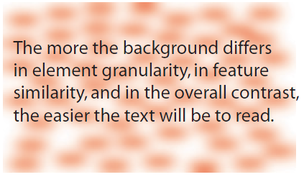

Pattern Interference

Slide 48
Patterns in Motion
How can we use motion as a display technique?
Gestalt principle of common fate

Slide 50
Motion is Highly Contextual
Group moving objects in hierarchical fashion.

Slide 51


Slide 52
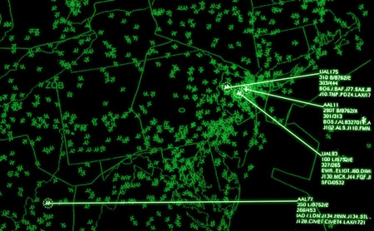

Slide 53
Pattern Recognition as High-Level Activities
Can be learned and trained.
Intelligence analysts
Air traffic controller
Chess grandmasters
Complex patterns can be encoded for rapid processing.
The 10,000 hour rule

Slide 54
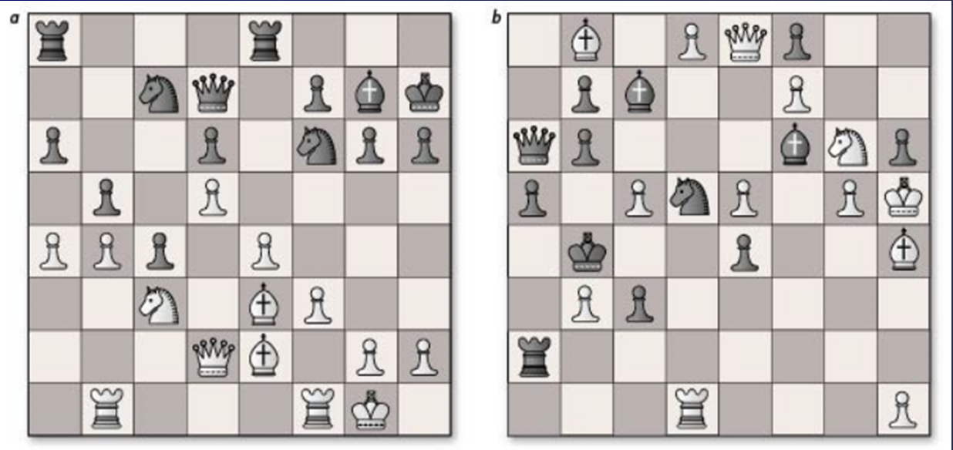

Slide 55
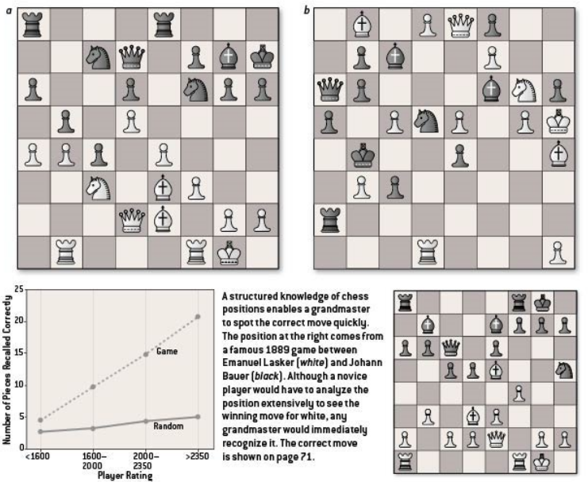

Slide 56
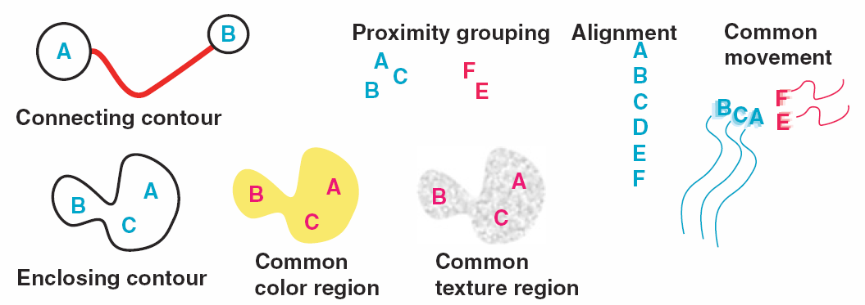
Design Implications
Patterns are about spatial relationship among objects.
Same group

Slide 57
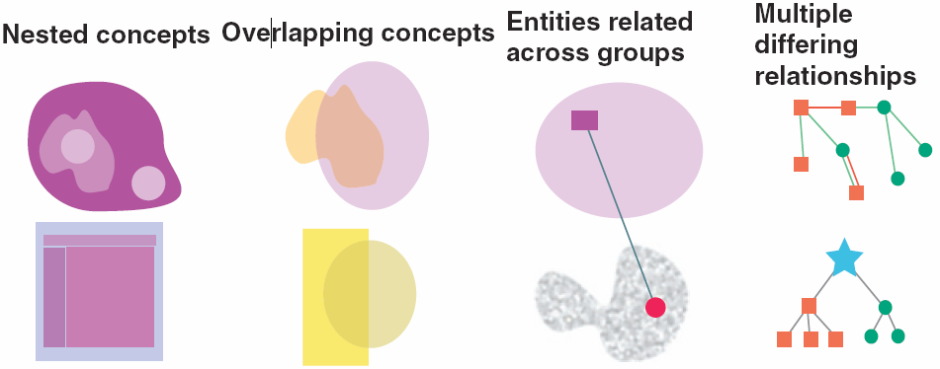
Design Implications
Patterns are about spatial relationship among objects.
Same group
More complex relationship

Slide 58
Design Implications
Patterns are about spatial relationship among objects.
Same group
More complex relationship
Apprehendable chunks in web design
News web sites

Slide 59
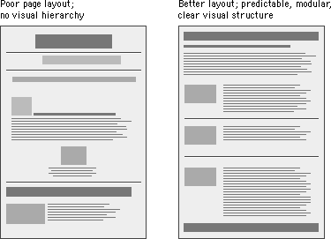

Slide 60


Slide 61
Design Implications
Patterns are about spatial relationship among objects.
Same group
More complex relationship
Apprehendable chunks in web design
News web sites
Semantic pattern mappings
Spatial properties, spatial alignment, spatial proximity, visual feature difference, visual feature similarity,

Slide 62
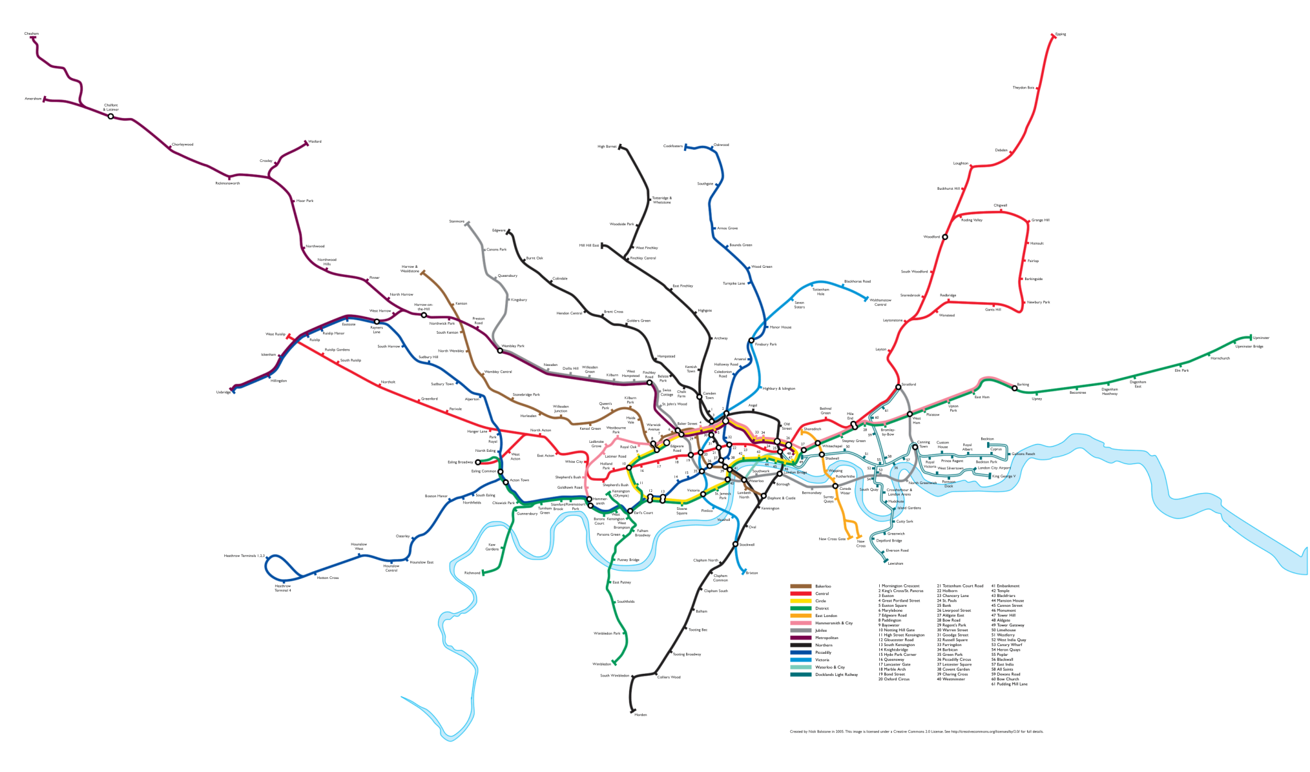

Slide 63
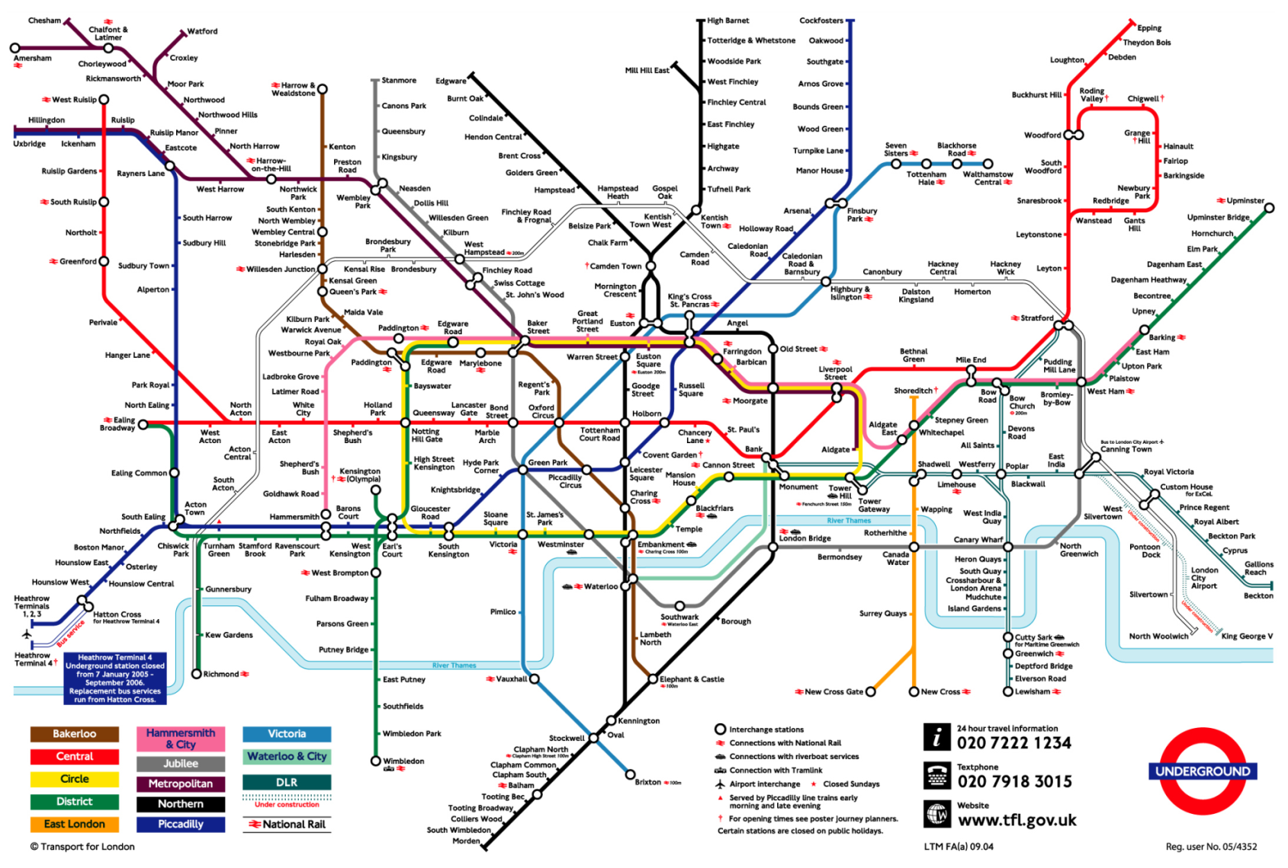

Slide 64
Programming Assignment 4 Tree Visualization

Slide 65

The Big Picture
Using other tree visualization techniques
Programming is not the focus.
Understand the codes.
Writing comments on codes
Chapter 5 in D3.js in Action
Format your data to fit the codes.
Modify some codes for your needs.

Slide 66
Tree Visualization Techniques to Use
Dendrogram
https://bl.ocks.org/mbostock/4063570
Data in the CSV format
Treemap
https://bl.ocks.org/mbostock/4063582
Data in JSON
Data to visualize
\\up.ist.local\Courses\Spring2017\IST402\ProgrammingAssignmentDataSets\Assignment4_TreeVisualization\tree.docx

Slide 67
Requirements
Dendrogram
Show the tree structure
Treemap
Show the tree structure and allow users to choose the spatial-partition factor.

Slide 68
Hierarchical/Tree Data Visualization

Slide 69
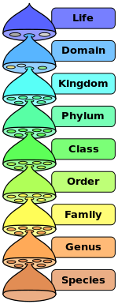
Tree Data (Hierarchical Data)
Everywhere
Physical world
Social systems
World, country, state/province, county, city/town, neighborhood
Computing systems
File systems

Slide 70
Why Hierarchy?
Each to manage large and complex systems.
Interrelated subsystems inside a hierarchy
Semi-independent
Affecting each other through what they do, not how they do.
Only outcomes matter, not processes.

Slide 71
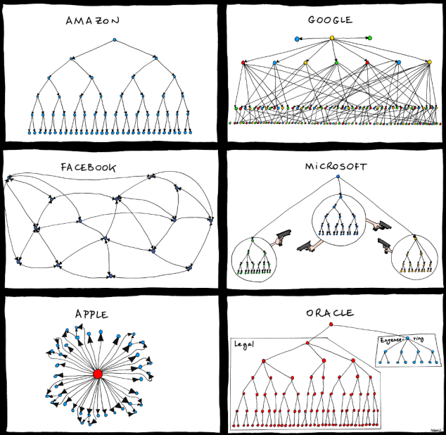
Visualization of Hierarchy

Slide 72
Major Challenges
Limited screen space for a vast hierarchy
What do people need to know about a hierarchy?
The location of a node
Its surrounding
Its higher or lower levels
Its attributes

Slide 73
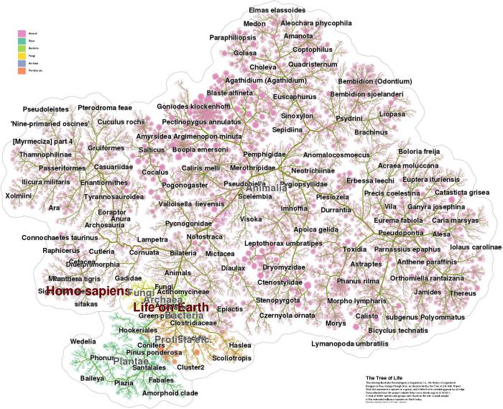
http://yifanhu.net/TOL/

Slide 74
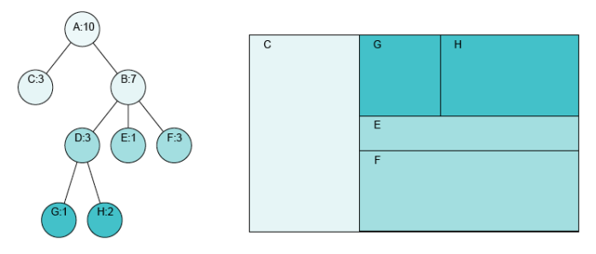
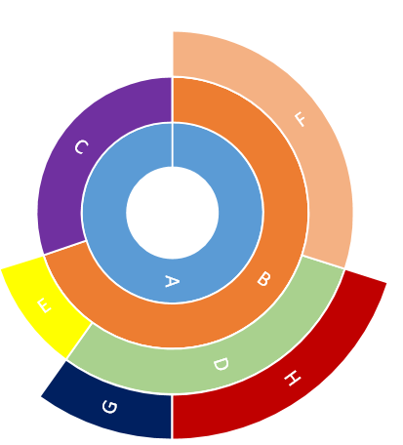
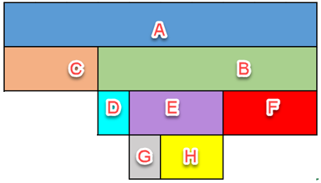
Classification of Tree Visualization Methods
Node-link: structure clarity
Space-filling: space efficiency
Adjacency diagrams: hybrid of node-link and space-filling

Slide 75
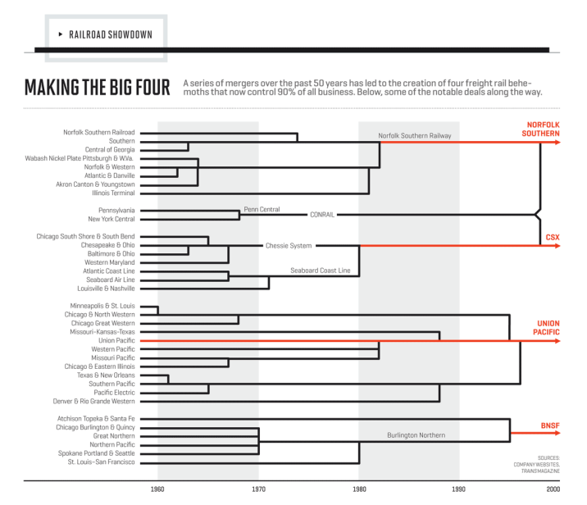
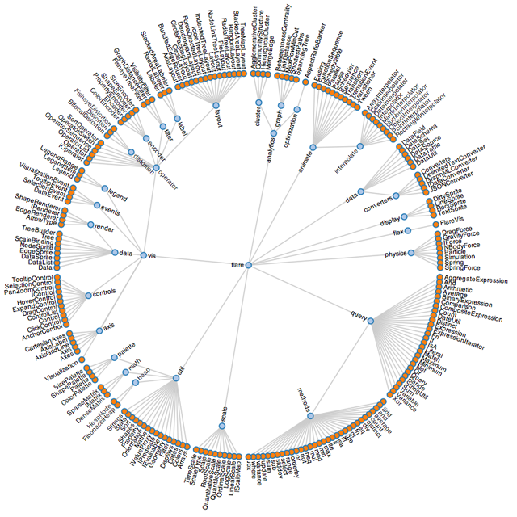
Node-Link

Slide 76
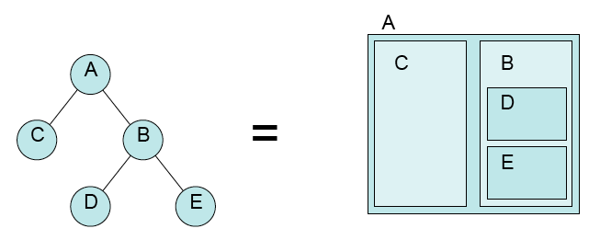
Space Filling Method
Not only hierarchy, but also a specific node attribute

Slide 77
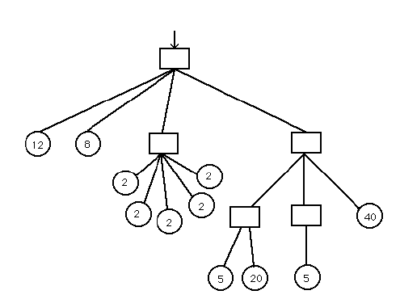
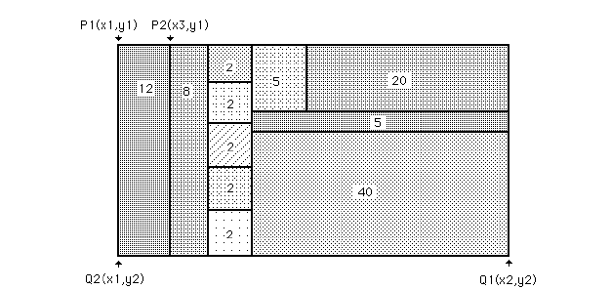

Slide 78
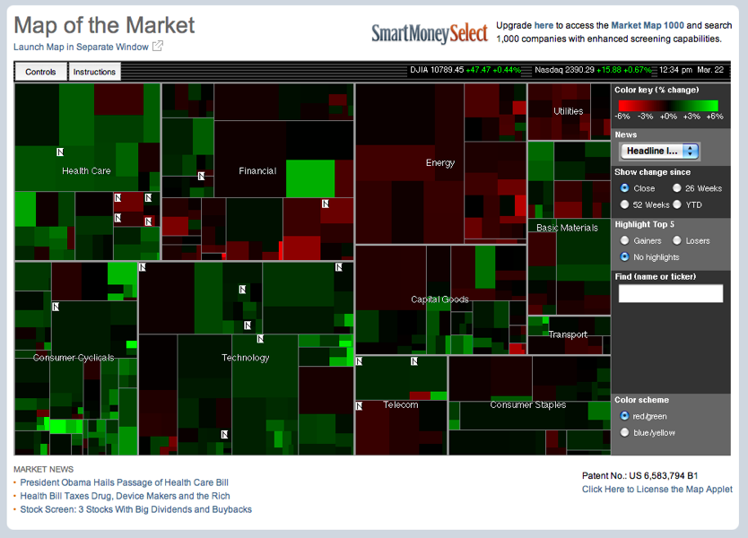

Slide 79
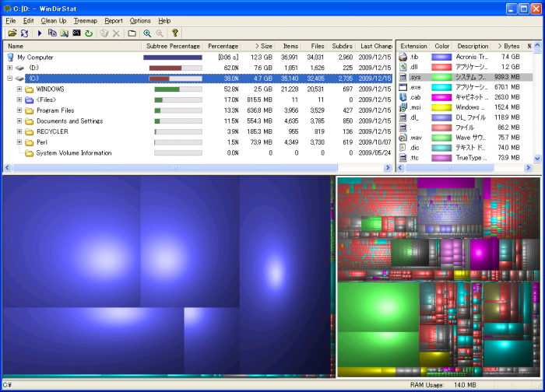
File Systems

Slide 80
Adjacency Diagrams
Node-link connections are still valid
Nodes are sized.

Slide 81
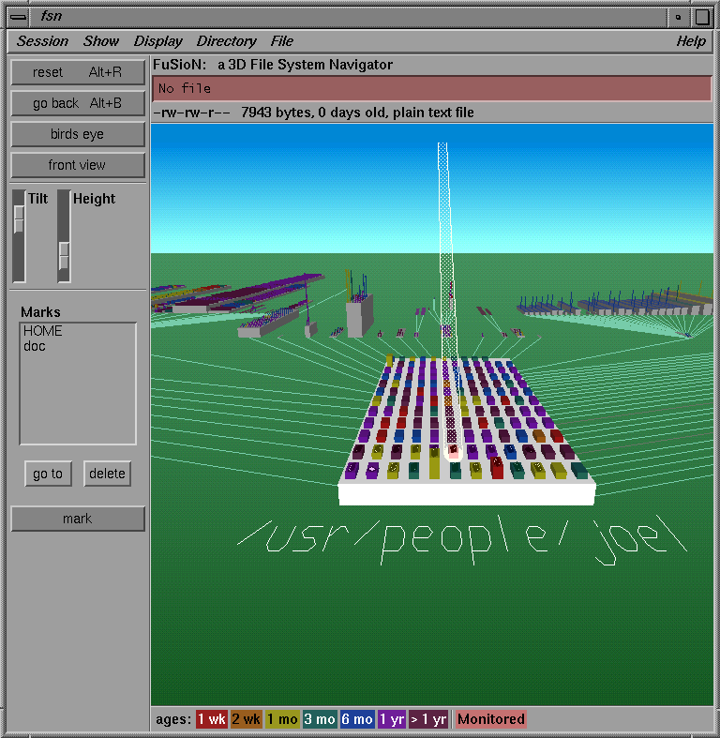
Others

Slide 82
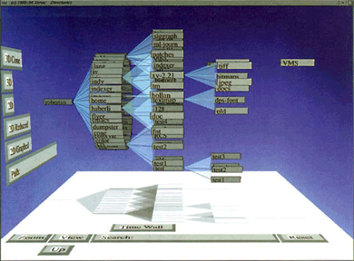
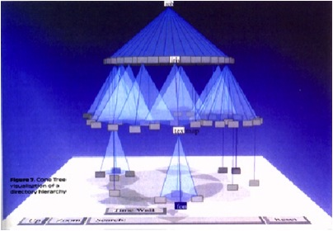

Slide 83
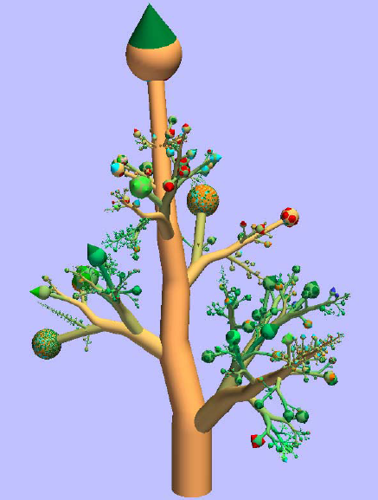

Slide 84
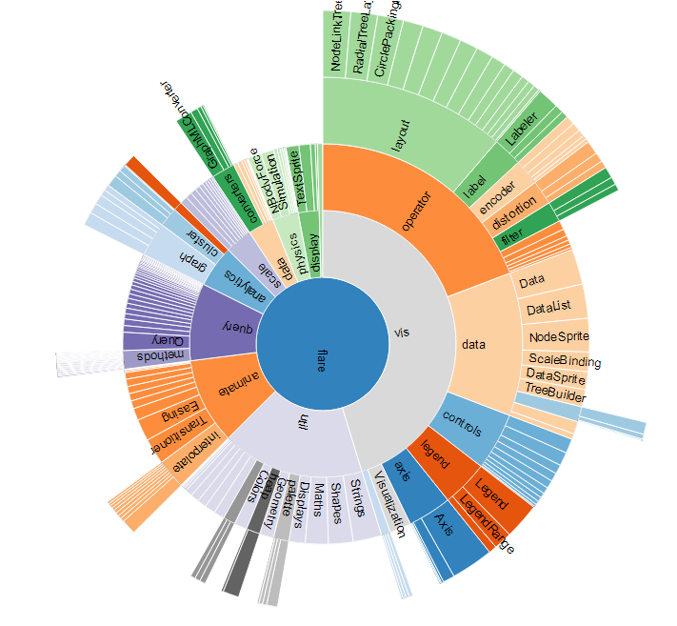
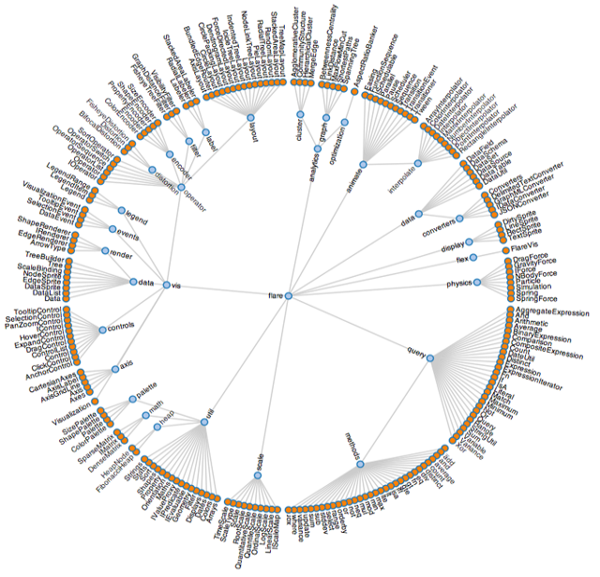
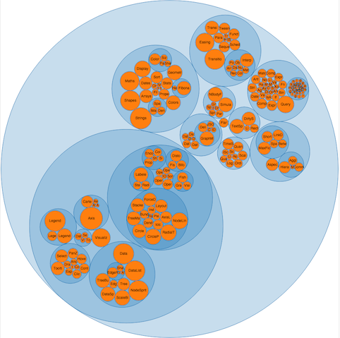
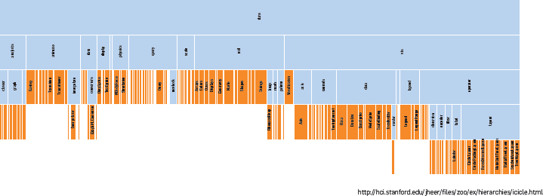
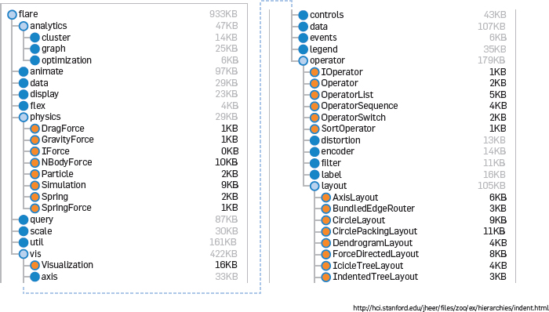

Slide 85
Pros and Cons
Node-link only
Easy to see as a whole
Inefficient in space use
Logical relationship only
Space-filling only
Quantitative comparison
Hard to understand the whole structure
Adjacency diagrams
Visually complex

